Slide 1
Predicting Video Engagement of Users
彭成全 林昌毅 曹書恒 蕭文逸 Vivian Er 劉淑雯

Slide 2
Content
Introduction
Dataset and features
Data preprocessing
Methodology
Results and discussion
Conclusion

Slide 3

Hopenglish
Platform for users to learn English in an engaging and interesting way
But some users do not complete the video and listening tests
Suitable match between video and user will sustain user’s interest in using the website

Slide 4

How can we know if a video engages
the student?

Slide 5

Goal
To predict if the student will complete the video, including the tests
View is incomplete when user has a score of -1 for any one section of the video

Slide 6

Dataset and Features
STUDENT
3096 students
Variables: chosen video ID, listening scores, list of saved words from video
Score of -1: user did not complete the test for a particular section.
VIDEO
Variables: video ID, word level, video speed, subtitle length ratio, section length, word list

Slide 7
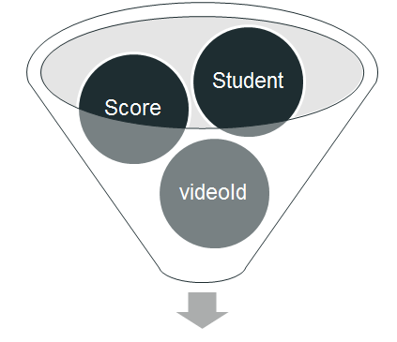
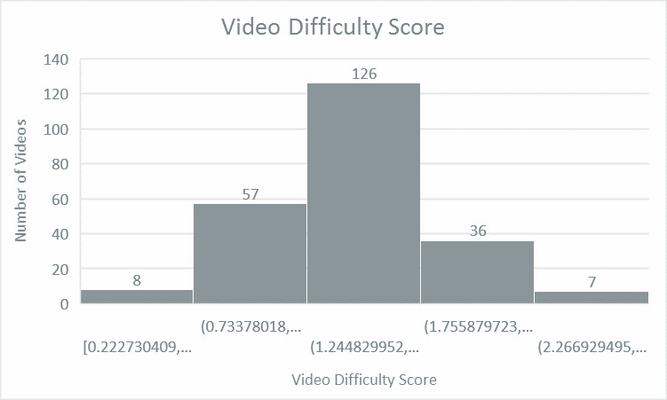
Preprocessing
Student dataset
Video dataset
Filter out data where users have a score of -1 or 0 for all sections of the video
Video Difficulty Level Classification

Slide 8
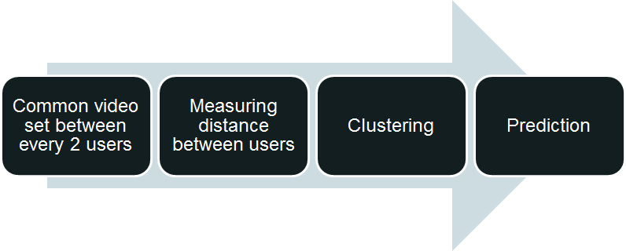
Methodology

Slide 9
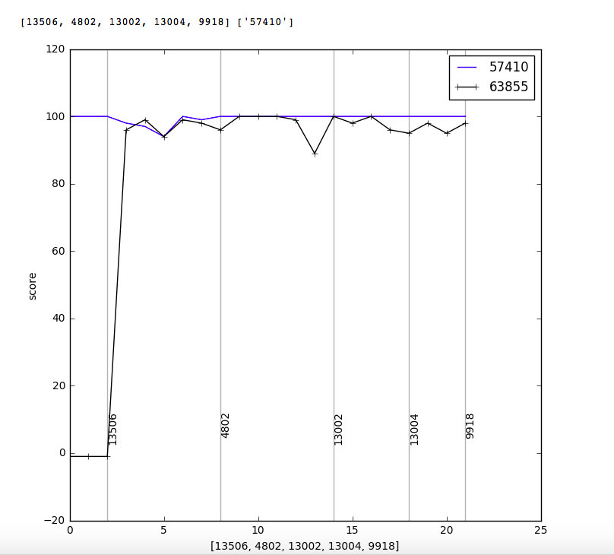
Methodology
Common Video Set
Create lists to append the student’s listening score to the corresponding video section
Us the list of videos watched by the students to find the common video sets between every two students

Slide 10
Methodology
2. Measuring distance between users
Create a vector for each student in the pair, consisting of the difference between the video score and average score of all the videos.
s₁ = [80, 90, 80, 70]
avg₁ = 80
v₁ = [0, 10 , 0, -10]
v₁ - v₂ =
[0, 10 , 0, -10]
— [2, 8 , 2, -12]
[-2, 2 , -2, 2]
Similarity =
|v₁-v₂ |
√|v₁|
s₂ = [74, 80, 74, 60]
avg₂ = 72
v₂ = [2, 8 , 2, -12]

Slide 11
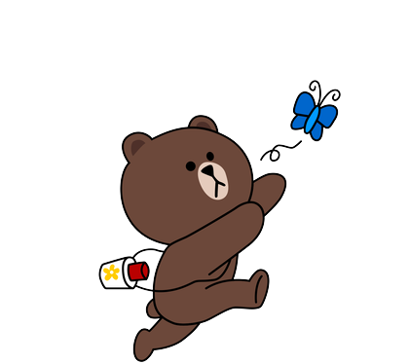
Methodology
3. Clustering
Use the distances compute earlier to construct the proximity matrix between every pair of student
Complete linkage hierarchical clustering is applied to find clusters of students with similar listening scores trends.

Slide 12
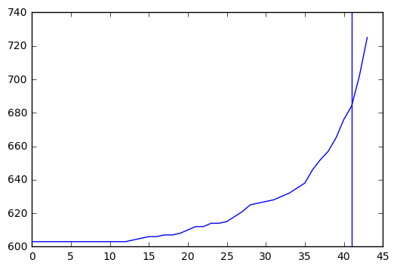
Methodology
3. Clustering
Compute the 'elbow' to find the common video set thresholds for clustering

Slide 13
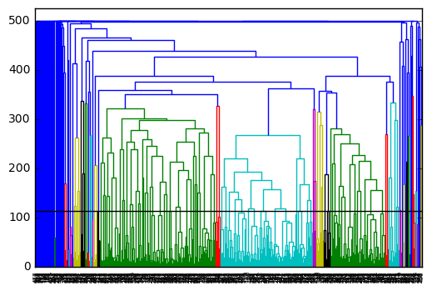
Methodology
3. Clustering
Clustering Results
(500 Data)

Slide 14
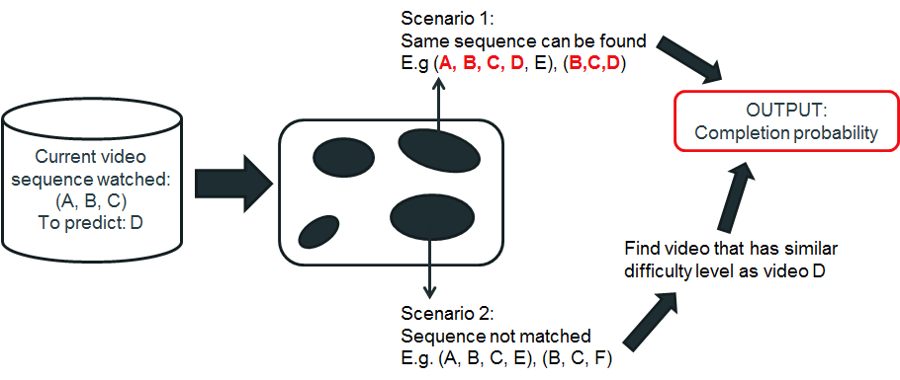
Methodology
4. Prediction

Slide 15
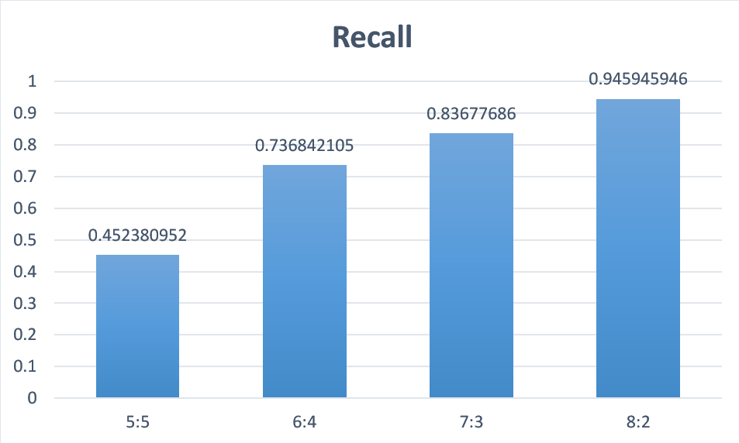
Results

Slide 16
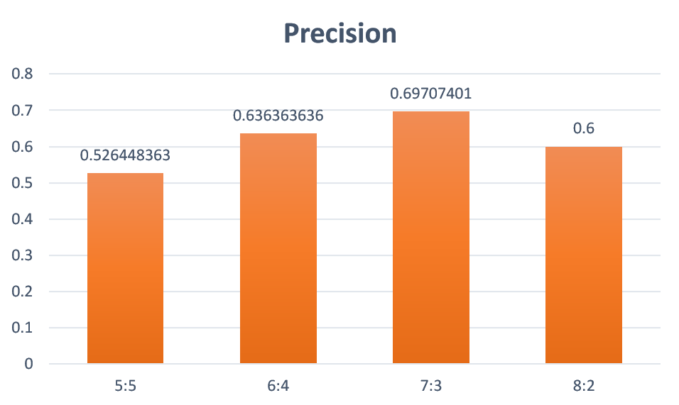
Results

Slide 17
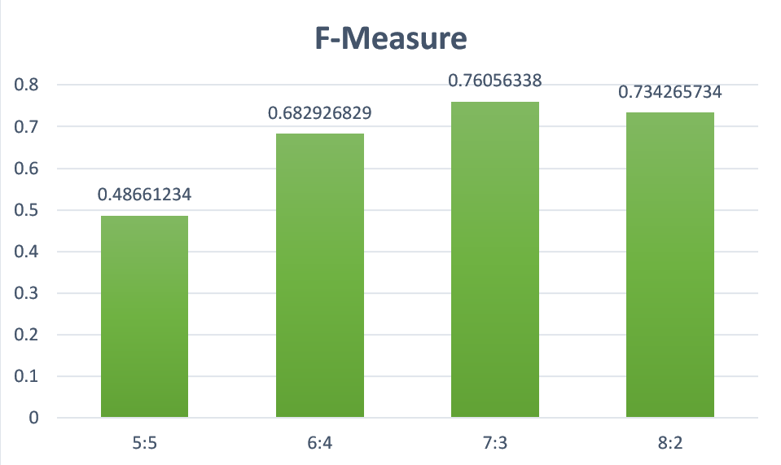
Results

Slide 18
Conclusion
Results can enable Hopenglish to determine if the video should be recommended to the user
Improve the matching between video difficulty level and student level
Enhance the quality of service for users

Slide 19
THANK YOU

